Slide 1



24-hour programming contest!

Slide 2
IEEE Mission & Vision
Mission statement
IEEE's core purpose is to foster technological innovation and excellence for the benefit of humanity.
Vision statement
IEEE will be essential to the global technical community and to technical professionals everywhere, and be universally recognized for the contributions of technology and of technical professionals in improving global conditions.

Slide 3

The Institute of Electrical and Electronics Engineers (IEEE, pronounced "I triple E") is a professional association. It was formed in 1963 from the amalgamation of the American Institute of Electrical Engineers and the Institute of Radio Engineers. Today, it is the world's largest association of technical professionals with more than 400,000 members in chapters around the world.

Slide 4

IEEEXtreme is a global challenge in which teams of IEEE Student members—advised and proctored by an IEEE member, and often supported by an IEEE Student Branch—compete in a 24-hour time span against each other to solve a set of programming problems. IEEEXtreme 10.0 will be held on 22 October 2016. Save the date. Thank you to all the past participants, and a warm welcome to all future programmers.

Slide 5
History
IEEEXtreme began in 2006, has been hosted for 9 different years, and will enjoy its 10th year of competition in October, 2016.
The first competition in 2006 attracted 47 teams with 150 participants.
The most recent iteration of IEEEXtreme, in 2015, enjoyed the registration of over 2,300 teams, participation of over 1,900 teams, 5,500+ student competitors, 600+ proctors, and 100+ volunteers around the world.

Slide 6
Competition
Teams of three student IEEE members
Solve a sets of programming problems over 24 hours, starting at 0:00 GMT on the competition date.
All teams receive the same problems to solve and are expected to solve the problems without direct outside consultation.
Teams don’t need to tackle every problem, but the more they solve, the more points they score.
Students submit their solutions using an online tool, which has been HackerRank in recent years. Points are awarded based on how the problem was solved, the time it took, and its difficulty. Higher-grade IEEE members serve as judges and proctors for the competition.

Slide 7
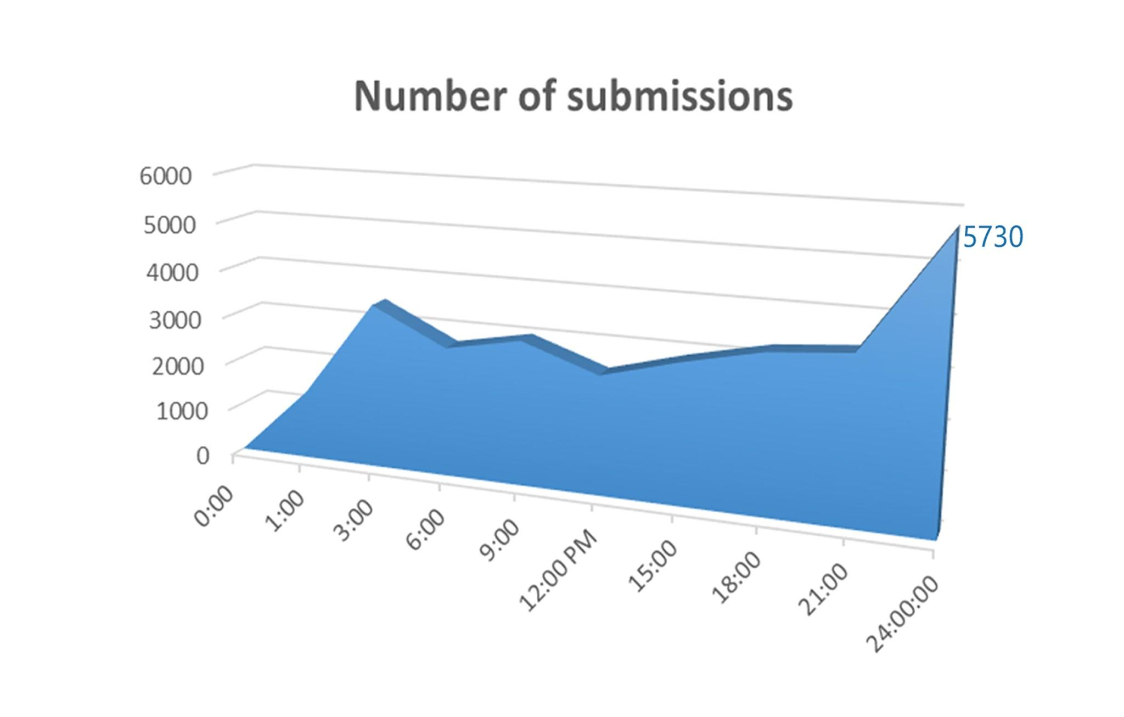
Xtreme 9.0 | Stats

Slide 8
Why participate ?
For Fun
Glory
Community
Learning
Sharpen your programming skills
Get hired by top companies
And More..
Notes:
What is the purpose of solving challenges?
For Fun. What can be more exciting than solving challenging problems? We have also added helpful features to make your coding experience enjoyable, such as providing boilerplate code and displaying animations of your running code.
Glory. As you solve more challenges, you will earn points, and move up in the HackerRank Leaderboard. Many challenges will also involve a competition between your bots and the bots coded by other hackers, so may the best hacker win!
Community. We are building a community of hackers who will be able to discuss problems, learn, compete and collaborate together.
Learning . You will be able to learn new programming topics and techniques by going through the challenges on HackerRank. We believe the way to learn something is by doing it.
And More.
<number>

Slide 9
Practice Practice
https://www.hackerrank.com/
http://code.google.com/edu/languages/google-python-class/
https://www.codechef.com/problems/school
http://www.codingbat.com/
The Programming world
Notes:
Some of the links where you can practice programming...
<number>

Slide 10

Important Dates
IEEEXtreme Registrations opening on
16th August 2016

Slide 11
Q & A
# include <skills.h>
# include <knowledge.h>
void main (participate)
{
printf (“Thank You !!”);
getch();
}

